Slide 1
Analytical CRM Development for Bank

Slide 2
agenda
Problem Statement
KPIs
Objective Metrics
Subjective Insights
Final tips & takeaways
Visualization

Slide 3
Problem statement
As an analytical CRM (Customer Relationship Management) specialist hired by a bank, extract meaningful insights from various customer-related datasets. The bank aims to reduce customer churn, improve service delivery, and enhance customer satisfaction. They have provided you with datasets including customer demographics, transaction details, customer exit information, and active customer profiles.

Slide 4
Key Metrics
Total Customers
10K
Lost Customers
2037
Customer Churn Rate
20.37
Average Tenure
4.86 years
Average No. Of Products
1.53
Active Members
5151

Slide 5
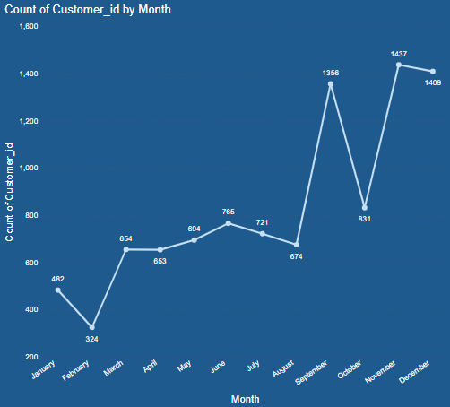
Time flow- customer ACQUISITON
Customers can be seen increasing in the end months.
Specifically, in September, November & December.
New Year Resolutions: Financial planning for the upcoming year prompts new account commitments.
Holiday Spending: Customers open accounts to manage expenses during peak holiday periods.
Promotional Campaigns: Banks offer enticing year-end promotions, incentivizing new customer acquisition before year-end.

Slide 6
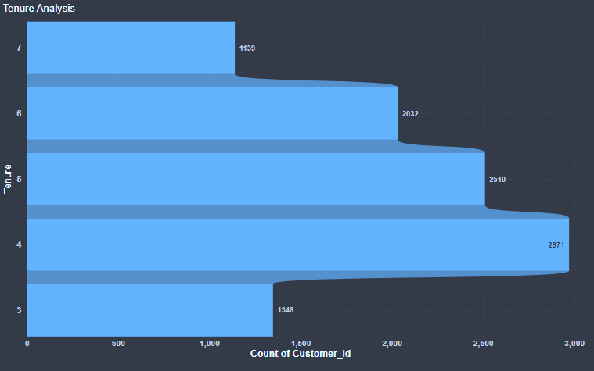
Customer Lifetime value- tenure analysis
The average tenure across all categories and segments is around 4 years.
The below categories are really important in predicting the lifetime value of the customers for the following reasons-
  Credit Score Status: Higher scores often indicate better repayment behaviour & financial stability, predicting longer customer lifetimes & increased value.
  Credit Card Usage: Customers with credit cards may exhibit higher spending & transaction frequency, leading to greater lifetime value potential.
  Member Activity: Active members are more likely to stay engaged & loyal, resulting in longer-lasting relationship & higher lifetime value.
  Number of Products: Customers using multiple products tend to be more integrated into the ecosystem.

Slide 7

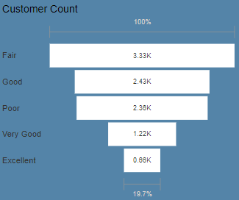
financial health status- credit score
Majority of our customers have a Fair or Good credit score.
Least of them are having an excellent score.
Bank must provide resources, counselling, and specialized products to help customers enhance creditworthiness.

Slide 8
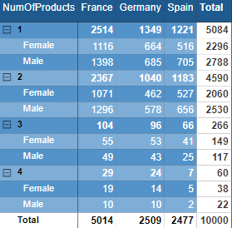
Navigating through products
Average No. Of Products
1.53
* Most of our customers are using just one product currently.
* The count of customers is substantially lesser with more number of products.

Slide 9
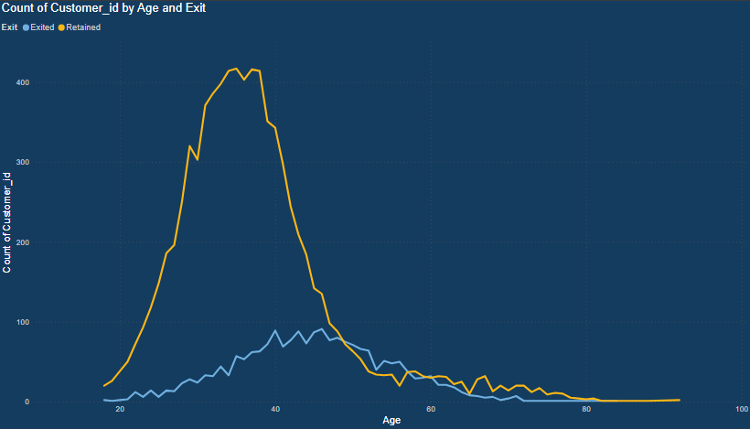



Demographic comparison- gender & age

Slide 10
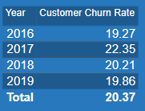
Along the years- customer churn
2017 had the highest amount of customers exiting the bank at 22.35% churn rate.
The next 2 years saw a drop in churn rate which gives a positive note.
The bank has to continuously adapt to emerging needs of its customers to maintain their value and satisfaction which would lead to decreased rate of exit.

Slide 11
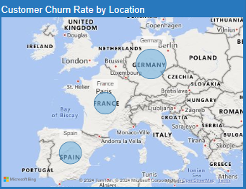
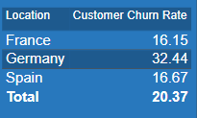
Across the regions- customer churn
Germany has the highest rate of customer churning the bank at 32.5%
Followed by Spain & France.
There could be many factors for exit. We would have to do a deeper analysis location-wise to see the problems and find specific solutions.

Slide 12

Common factors- customer churn
  A Fair & Poor credit score status.
  Has credit card
  Is not an active member
  Has been using only 1 product
  The customer is with the bank since 4-5 years.

Slide 13
Digging deeper insights- exit reasons
Based on the factors seen in last slide, several reasons could lead a customer with these attributes to exit the bank:
Limited Product Offering: The customer might feel that the bank isn't providing enough value beyond the one product they're currently using. If they require additional services or products and find better options elsewhere, they might decide to leave.
Poor Customer Service: Despite being with the bank for several years, if the customer hasn't felt adequately supported or valued by the bank's customer service, they might switch to a competitor who offers better assistance and responsiveness.
Better Offers Elsewhere: The customer might have received attractive offers from other banks, such as lower interest rates on loans or better reward programs on credit cards.
Changing Needs: Over the course of 4-5 years, the customer's financial situation and needs may have evolved. If the bank has not adapted its offerings or communicated effectively about how they can meet the customer's changing needs, the customer may look for a more suitable financial partner elsewhere.
Issues with Credit Score: With a fair credit score status, if customers encounter difficulties in managing their credit card or other financial products, they might seek a fresh start with a different bank that offers better terms or assistance in improving their credit situation.
Competitive Market: In a competitive banking landscape, customers have numerous options to choose from. Even if they've been with the bank for several years, they might be pulled by promotional offers or better services from competitors, forcing them to switch.

Slide 14
Reconciliation remedies- overcoming churn
Here are some strategies to decrease the churn rate:
Onboarding Experience: Clear information, tutorials, and assistance for new customers to
understand benefits and importance of multiple products.
Engagement Campaigns: Personalized messages and rewards to encourage activity among inactive customers.
Product Bundling: Discounted packages promoting convenience and cost-effectiveness of having multiple products.
Credit Score Improvement: Resources, counselling, and specialized products to help customers enhance creditworthiness
Proactive Customer Support: Monitoring and outreach to address issues promptly, improving satisfaction and loyalty.
Feedback Mechanisms: Encouraging feedback to identify areas for improvement and to meet customer preferences.

Slide 15
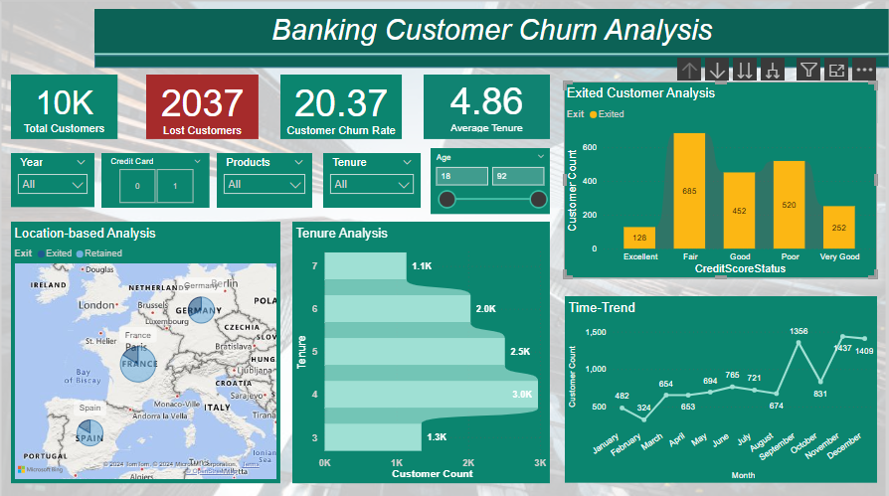
Power of visualization- dashboard

Slide 16
Thank you
Tasneem Khachrodwala
Newton School
Data Science Program- November Batch

